Slide 1

SDM COLLEGE OF ENGINEERING AND TECHNOLOGY,DHARWAD-580002 Department of Information Science & Engineering
“CET Rank Prediction and College Recommendation using ML Model”
Presented By
Abhishek Renjal-2SD19IS002
Karthik Kavathekar-2SD19IS024
Nagaraj L-2SD19IS028
Samarth M-2SD19IS042
Sandesh Bhat-2SD19IS043
Guided by Co-ordinator
Prof. Arati Nayak Prof. Varsha Jadhav
Project ID-P19

Slide 2
Contents
SL.NO | ContentCONTENT | Slide noIDE NO
1 | Problem Title | 4
2 | Problem Definition | 5
3 | Technologies Used | 6
4 | Objective of the Project | 7
5 | Methodology | 8
6 | Existing System and Proposed System | 9
7 | Architectural Design | 10
8 | Implementation Results | 11

Slide 3
SL.NO | Content | Slide no NO
9 | Limitations | 18
10 | Applications | 19
11 | Future Scope | 20
12 | Conclusion | 21
13 | References | 22
14 | Paper Publication Details | 23

Slide 4
Problem Title
CET Rank Prediction and College Recommendation using ML Model

Slide 5
Problem Definition
The problem is to develop a machine learning model that can predict the rank of a student in the Common Entrance Test (CET) and recommend suitable colleges based on the predicted rank. Additionally, it should recommend colleges that align with the predicted rank and match the preferences of the students, such as location, course availability, infrastructure, etc.

Slide 6
Technologies Used
SQL: SQL is a standard language for managing relational databases, which store data in tables with columns and rows.
HTML and CSS: HTML is the markup language used to structure and define the content of a web page. CSS is used to style the content on a web page.
Firebase: Firebase is a mobile and web application development platform that provides a suite of services and tools for building and managing applications.
Django Framework: It is a high-level Python web framework that is designed for rapid development of web applications.
JavaScript: JavaScript is a scripting or programming language that allows you to implement complex features on web pages.
Python: Python is an interpreted, object-oriented, high-level programming language with dynamic semantics.

Slide 7
Objective of the Project
Accurately predict the rank of a student in the KCET exam based on their performance in previous exams, demographic details, and other relevant factors.
Provide students with relevant information about the recommended colleges, such as their admission process, fee structure, and eligibility criteria.
The recommendation system should take into account factors such as the reputation of the college and the student's location preference.

Slide 8
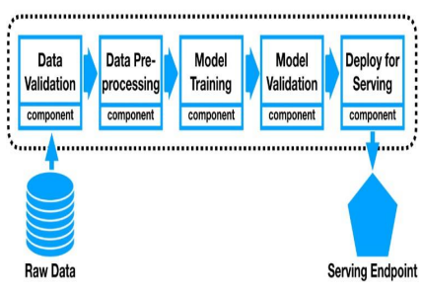
Methodology
Data Collection
Data Analysis
Data Pre-processing
Model Training
Model Validation
Deployment

Slide 9
Existing System & Proposed System
Rank prediction is very significant to students, teachers, university board trustees and government. People can observe the current rank of a university from those ranking providers. But ranking is a transitional and everchanging process. If upcoming rank of a certain university can be predicted, it would certainly assist the prospective graduate students to choose desired institution in advance. So it’s difficult for students to predict their appropriate rank to get admission to specific college.
In the proposed system The KCET rank predictor aids in predicting the expected rank. The data in the KCET rank predictor are based on various parameters and take the prior years’ exam pattern into account. It will also demonstrate how to compute rank using percentiles. We have used different types of algorithms, techniques to predict the rank of the students.

Slide 10
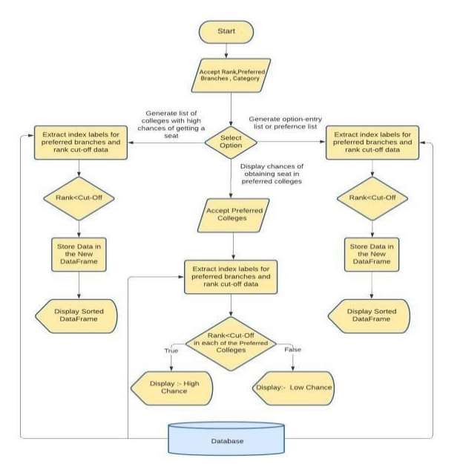
Architectural Design

Slide 11
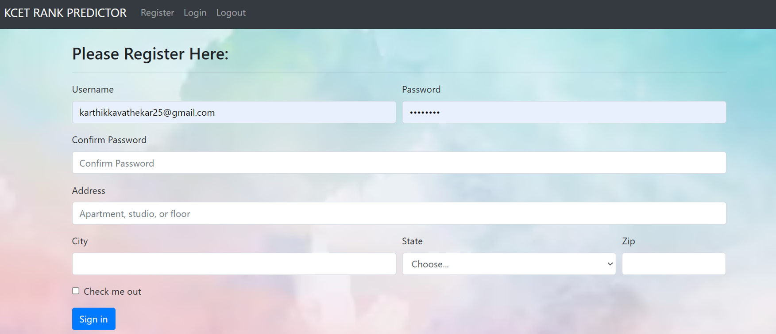
Implementation Results

Slide 12


Slide 13


Slide 14
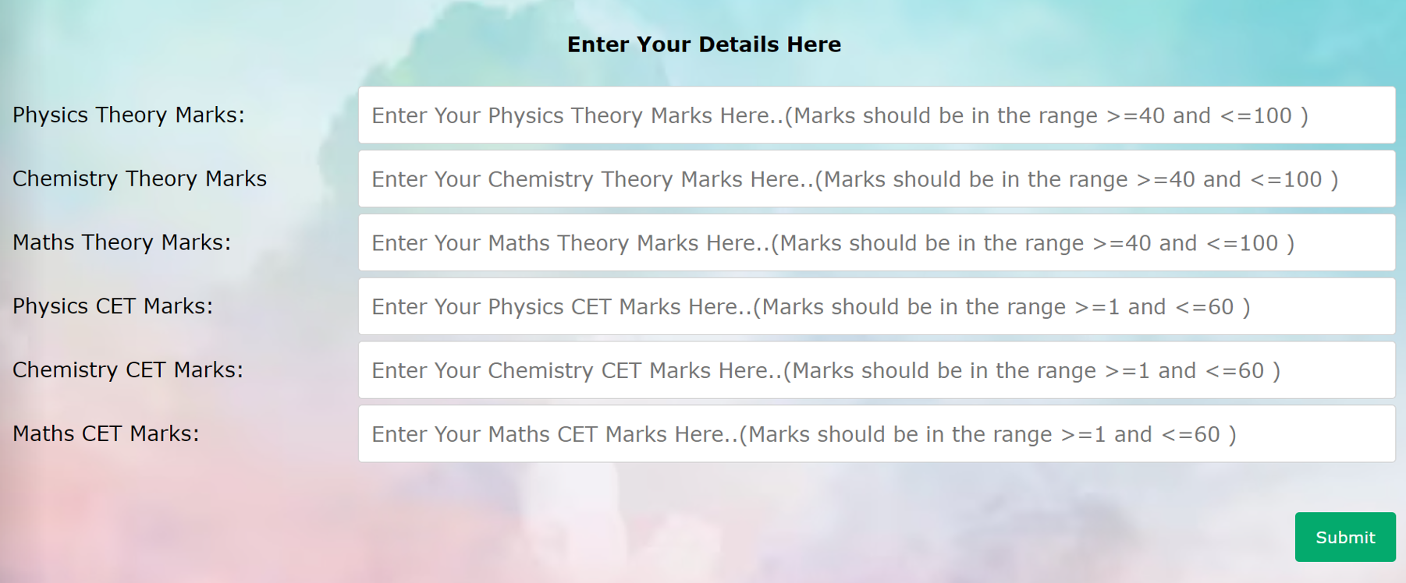

Slide 15
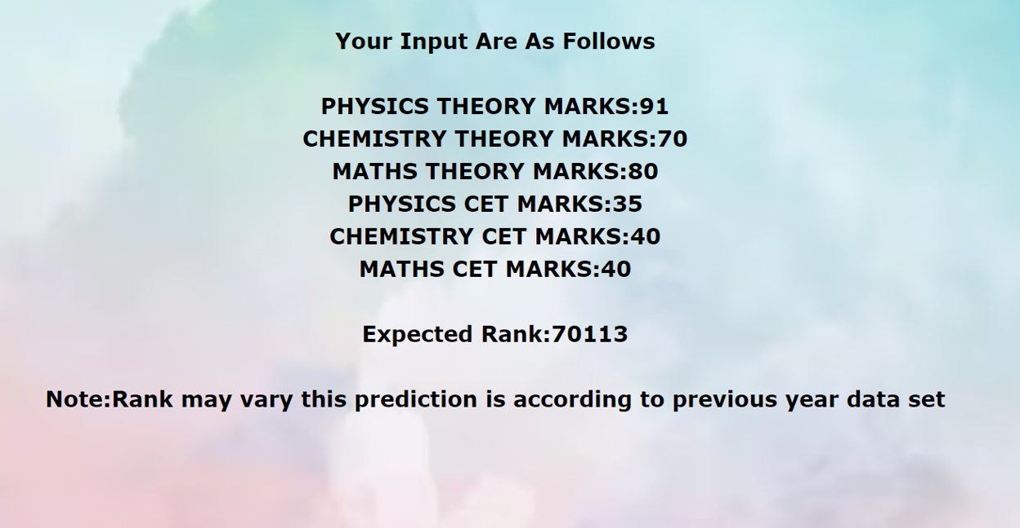

Slide 16
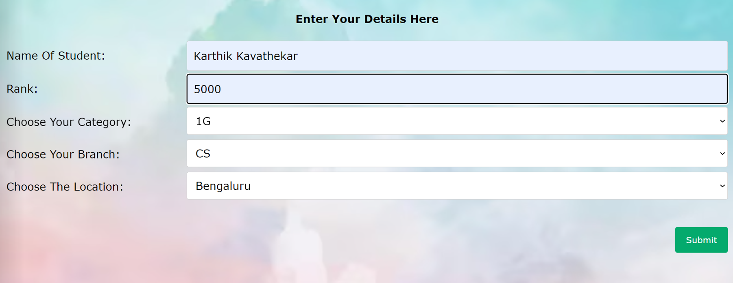

Slide 17
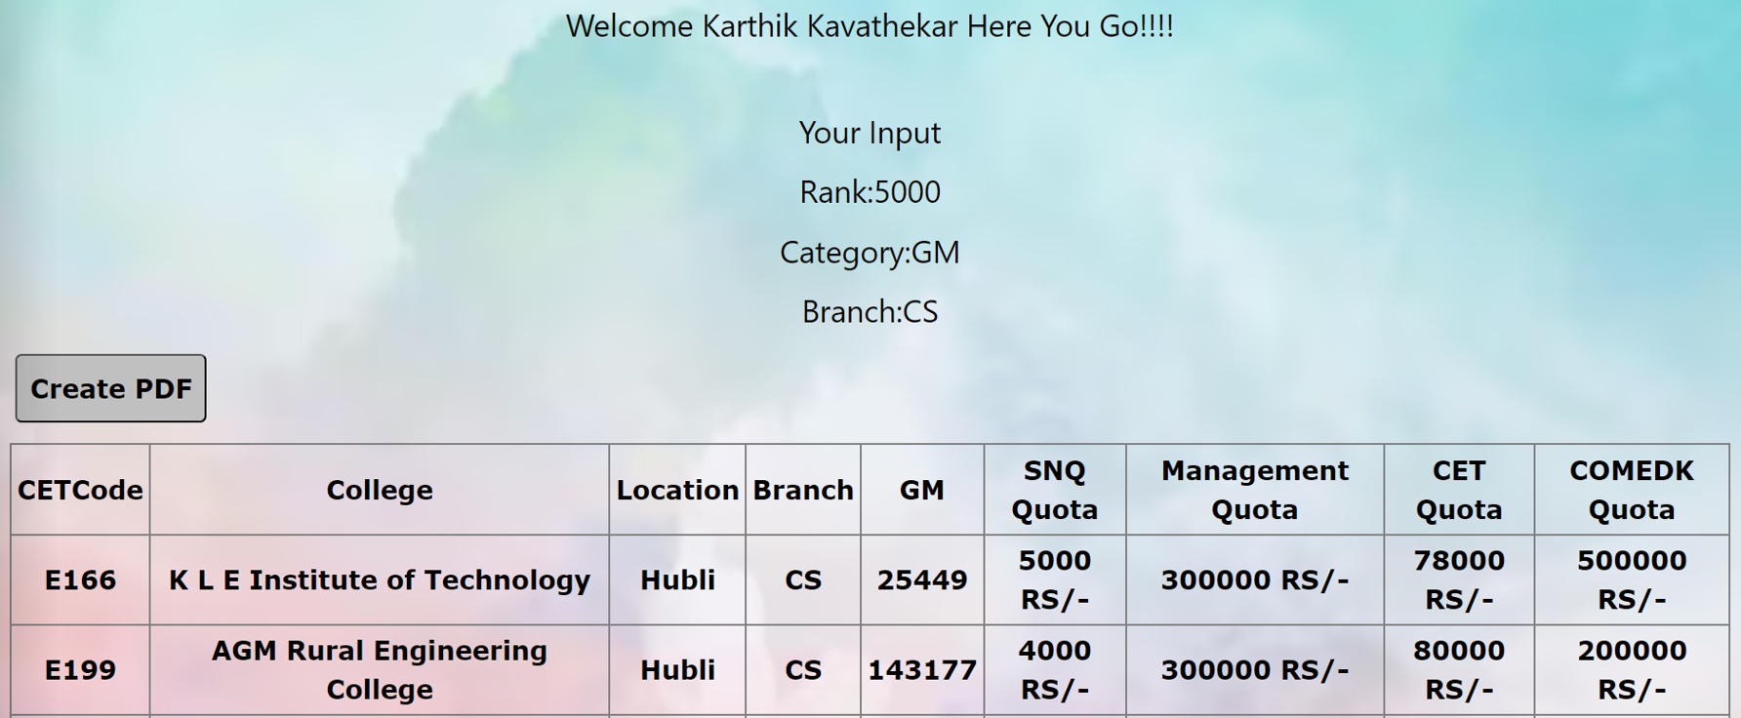

Slide 18
Limitations
In this model it’s hard to get 100% accuracy
If you’ve ever trained a machine learning algorithm, you know how long the process can take. Machine learning is a computationally-intensive process, so you need a powerful machine to handle the load. Modeling an ML involves matrix operations, and the neural networks can have millions of parameters to train.

Slide 19
Applications
Assist candidates in estimating their probable rank.
Candidates will get an idea of which universities they must select during the Counselling session and which courses they will be able to pursue if they are accepted.
Assist candidates based on their preferable locations.
Provide detailed description on fees structure.

Slide 20
Future Scope
Integration with other entrance exams: The system can be expanded to include other entrance exams such as JEE, NEET, and CAT. This can provide a more comprehensive view of a student's academic potential and career aspirations.
Enhanced personalization: The system can be enhanced to provide even more personalized recommendations based on a student's interests, career goals, and personality traits.
Integration with social media: The system can be integrated with social media platforms to provide a more engaging and interactive experience for students. This can also help students connect with other students who have similar interests and career aspirations.
Mobile application: The system can be developed as a mobile application that students can use on the go. This can provide a more convenient and accessible experience for students who are always on the move.

Slide 21
Conclusion
As we know that many websites are previously present which helps to determine the students rank based on some parameters , but our project predicts both the rank and the college as he/she can get admit into college based on their PU scores and CET marks obtained along with other criteria such as caste, location, fees structure. This will help students to make arbitrary decisions before the process starts.

Slide 22
References
[1] J. Han, J. Pei, and M. Kamber , Data mining: concepts and techniques .Elsevier , 2011.
[2] C.C Agarwal ,Data mining: the textbook. Springer, 2015.
[3] D. J. Power, R. Sharda, and F. Burstein, Decision support systems. Wiley Online Library, 2015.
[4]“Times world university rankings, https://www.timeshighereducation.com/worlduniversity-rankings, accessed: 201610- 30. [5]“Dataset of world university rankings,” https://www.kaggle.com/mylesoneill/world-university-rankings, accessed: 2016-10-12
[5]X. Geng , T.-Y. Liu, T. Qin, and H. Li, “Feature selection for ranking,” in Proceedings of the 30th annual international ACM SIGIR conference on Research and development in information retrieval. ACM, 2007.
[6] F. Xia, T.-Y. Liu, J. Wang, W. Zhang, and H. Li, “Listwise approach to learning to rank: theory and algorithm,” in Proceedings of the 25th international conference on Machine learning. ACM, 2008, pp. 1192– 1199.
[7] Z. Cao, T. Qin, T.-Y. Liu, M.-F. Tsai, and H. Li, “Learning to rank: from pairwise approach to listwise approach,” in Proceedings of the 24th international conference on Machine learning. ACM, 2007, pp. 129–136.
[8] M. N. Volkovs and R. S. Zemel, “Boltzrank: learning to maximize expected ranking gain,” in Proceedings of the 26th Annual International Conference on Machine Learning. ACM, 2009, pp. 1089–1096

Slide 23
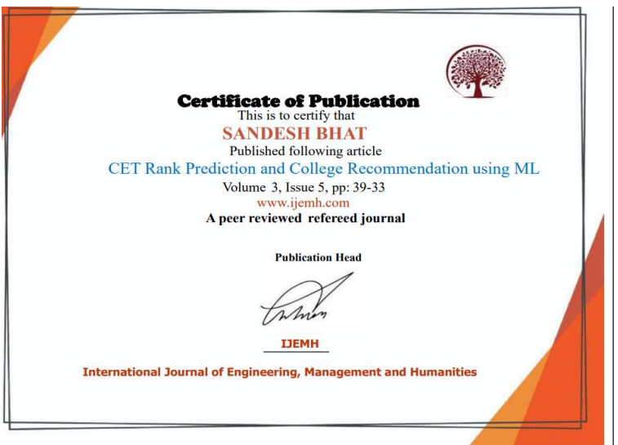
Paper Publication Details
Published a paper in “International Journal of Engineering, Management and Humanities” on 25-26 May Online.

Slide 24
THANK YOU!!

